Slide 1
Independent Studies Quarter 4
Jackson Paull - period 8

Slide 2
Overview
This quarter I continued to work on my rogue lite sandbox, as well as began work on a platformer, however most of the contents in this slideshow shall be PONG which I designed towards the end of the quarter with the intention of completing most of the TEKS from the get go.

Slide 3
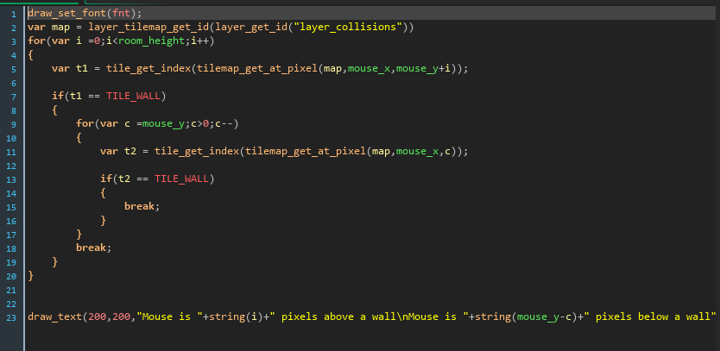
Looping
In this section of code I used nested loops to check how many pixels above or below an edge the mouse is. This was important as I later used a similar method to provide quick pre-collision detection which moves an object to the edge rather than into the object before shoving them back to the top.
Notes:
Pong: DEBUG_MouseIsPixelsAbove

Slide 4
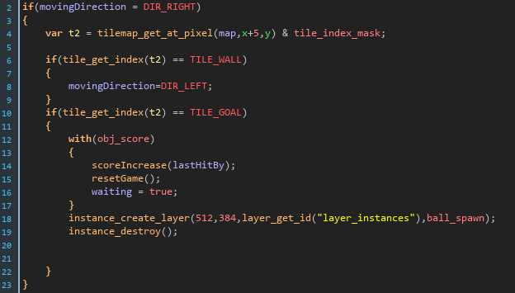
Data Structures
Here I use data structures to keep track of the tile-type of the tilemap that an objects intersects with on its very outer bounds. This is integral to being able to quickly process collisions with multiple collision types and thus responses.
Notes:
Pong: Process Ball collisions t1&&t2

Slide 5
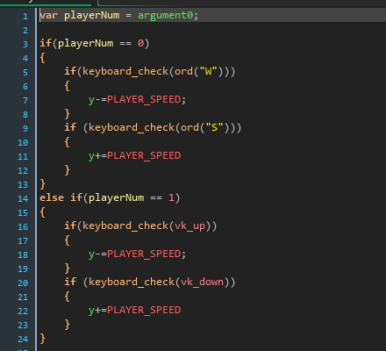
Input and Output
Here I run checks for the player’s moving the paddles. This section is largely self explanatory, and is extremely easy to understand. The code simply moves the players accordingly to how the players intend.
Notes:
Pong: processPlayerMovement

Slide 6
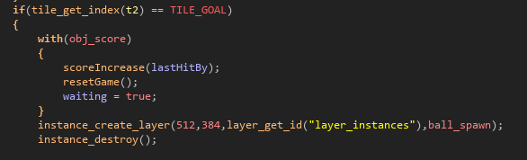
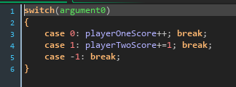
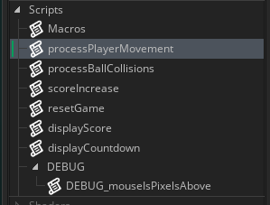
Methods
In the IDE I’ve been working in, methods are akin to things called “scripts.” They run the exact same way but are all global. Here I use a script to increase the score count for the given player.
Notes:
Pong: scoreIncrease

Slide 7
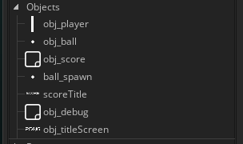
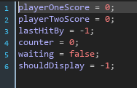
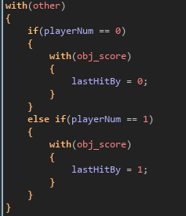
Classes
In my IDE classes are akin to objects. Here is the obj_player object, with instance variables being initialized in the create event (similar to the constructor). These variables are then changed and read through scripts, as well as some scripts dedicated entirely to the player object (similar to private methods). Then these objects are dealt with independently, with each instance having its own unique calls to methods and variable data.
Notes:
Pong player class

Slide 8
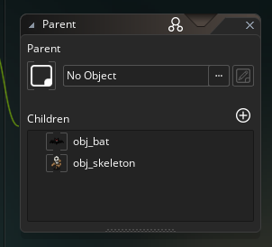
Inheritance
Here I use a parent object for all enemies to establish uniform instance variables. Given that scripts are all global, inheritance does not aid in that aspect here, but it allows me to eliminate the possibility that a variable is never initialized or otherwise.
Notes:
Rogue lite: enemy parent

Slide 9
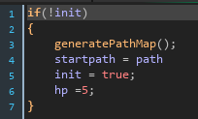
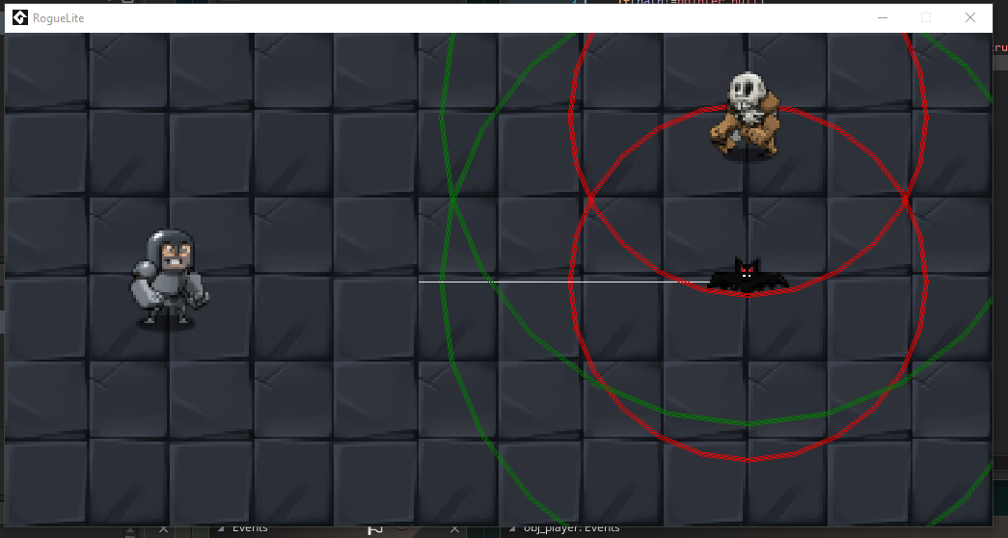
Polymorphism
Bat overriding some instance variables and initialization code
Here, enemies take different damage depending upon which child they are
Using inheritance overrides, the obj_bat and the obj_skeleton take different amount of hits until they die, as they are able to overwrite variables from the parent that they need to be unique with.
Run of the game with enemies next to each other

Slide 10
Jackson Paull, period 8, Quarter 4
Thank you, and have a great summer Mr Rosier

